Slide 1
INTERPERSONAL SKILLS

Slide 2

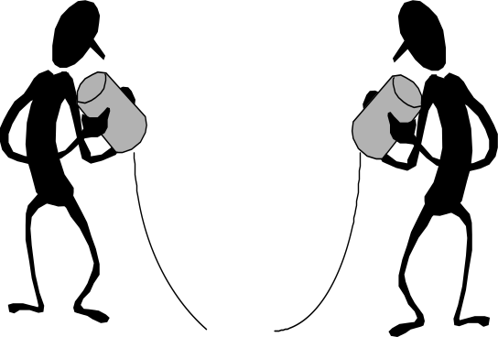


Interpersonal Skills/
Facilitation Skills
listening
questioning
language &
communication
using
feedback
conflict handling

Slide 3
ESSENTIAL IP COMPETENCIES
  Self awareness
  Control
  Motivation
  Acknowledging the interests of subordinates
  Communication skills

Slide 4
DEVELOPING IP Skills
Developing Assertiveness
Accepting Responsibility
Managing Conflicts
      Avoiding
      Accommodating
      Competing/Forcing
      Collaborating
      Compromising

Slide 5
Life Positions
I’m OK — I’m OK —
You’re not OK You’re OK
I’m not OK — I’m not OK —
You’re not OK You’re OK
Positive
Negative
Attitude toward Oneself
Negative Positive
Attitude toward Others

Slide 6

Management Conflict Styles
I’m
not OK —
You’re OK
I’m OK —
You’re OK
Passive
behavior
Assertive
behavior
High concern
for others’
needs
Accommodating
style
Collaborating
style
Compromising
style
Aggressive
behavior
Avoiding
style
Forcing
style
I’m
not OK —
You’re not OK
I’m OK —
You’re not OK
Low concern
for others’
needs
High concern
for own
needs

Slide 7
Factors Hampering Interpersonal Interactions
Poor Listening
Emotional Arousal
Lack of Time
Differences in objective

Slide 8
Eric Berne and Transactional Analysis
Transactional Analysis
  A unified system of individual and social psychiatry
  Focuses on the individual but also one’s relationship to others
A model for explaining why and how:
  People think like they do
  People act like they do
  People interact/communicate with others

Slide 9
Eric Berne and Transactional Analysis
Transactional Analysis
  People have three ego states: parent, adult, child
    Parent: when a person thinks, feels & behaves in ways copied from his/her parents
    Child: thinking, feeling, behaving as one did as a child
    Adult: thoughts, feelings, or behaviors that are a direct result of current happenings
  Key point: people shift in & out of these states

Slide 10
The Three Ego States
Parent- “Do as I do”
Child- “What shall I do?”
Adult- “I will be frank with you”
Biological conditions are irrelevant to these ego states.
We shift from one ego state to another in transactions.
Parent- “Why don’t you prepare a time-table?”
Child- “What is the point when one cannot follow it?” – Becomes an Adult.

Slide 11
Ego Portraits
People have favorite, preferred ego state, depicted by larger circle in a diagram
Parent Adult Child
P
P
P
A
A
A
C
C
C

Slide 12
Eric Berne and Transactional Analysis
Transactional Analysis – further development
  Parent & child ego states subdivided
    Parent state: controlling or nurturing
    Child state: free child (FC) or adapted child (AC)
      AC – a person conforms & adapts to demands of others
      FC – a person acts & feels like an uninhibited & unsocialized child
    Adult state: current self

Slide 13
Transactional Analysis
Transactional analysis (TA): a method of understanding behavior in interpersonal dynamics.
The three ego states
  Parent
    Critical parent
    Sympathetic/nurturing parent
  Child
    Natural child (affectionate playful)
    Adapted child
  Adult
The three types of transactions
  Complementary
  Crossed
  Ulterior

Slide 14
Types of Transactions
Complementary Transactions: Appropriate and Expected Transactions indicating healthy human relationships.
Communication takes place when transactions are complementary. A stimulus invites a response; this response becomes a stimulus inviting further response and so on.

Slide 15
Transactional Analysis Types (I)
Complementary transaction
  Supervisor Employee
P
P
A
A
C
C

Slide 16
Eric Berne and Transactional Analysis
Transactional Analysis occurs when the ego states of 2 people interacting is assessed
  Complimentary interaction:
    one person in a nurturing parent ego state
    other person in their adaptive child ego state

Slide 17
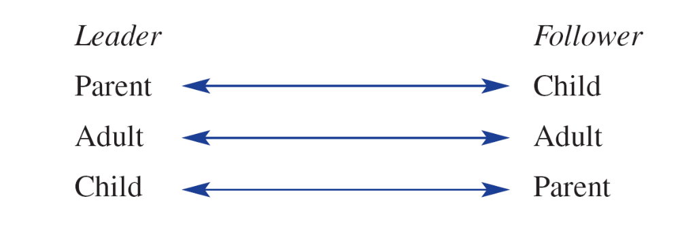
Eric Berne and Transactional Analysis
For a leader-follower, the following complementary transactions could occur:

Slide 18
Transactional Analysis Types (II)
Crossed transaction
  Supervisor Employee
P
P
A
A
C
C

Slide 19
Types of Transactions
Crossed Transaction: This causes most difficulties in social situations.
“May be, you should improve your study habits”.
“You always find fault with me whatever I do” Parent-Child interaction.

Slide 20
Eric Berne and Transactional Analysis
Transactional Analysis occurs when the ego states of 2 people interacting is assessed, cont’d.
  Crossed transaction:
    A leader in the adult ego state deals with
    A subordinate who responds from their free child ego state with somewhat negative, rejecting input from the leader

Slide 21
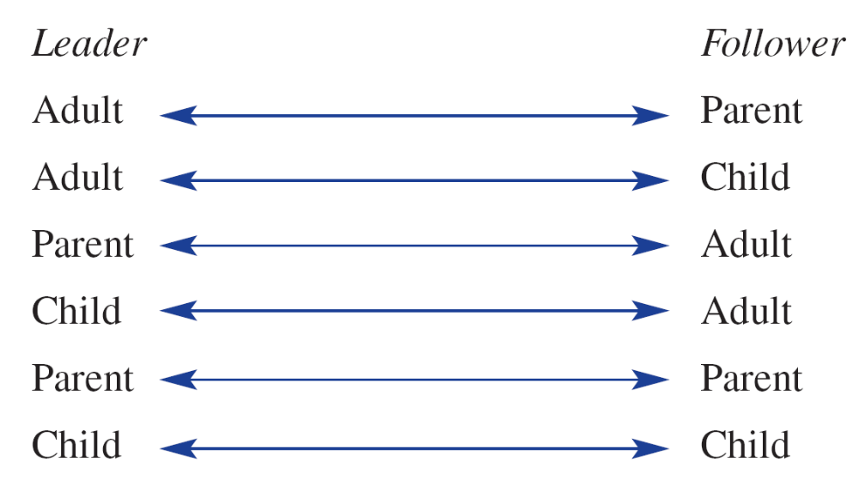
Eric Berne and Transactional Analysis
For a leader-follower, there are a number of possible crossed transactions:

Slide 22
Transactional Analysis Types (III)
Ulterior transaction
  Supervisor Employee
  Supervisor Employee
P
P
A
A
C
C
P
P
A
A
C
C

Slide 23
STROKES
Positive
Negative
Neutral

Slide 24
UTILITY
Communication
Motivation
Leadership

Slide 25
Interpersonal Skills
- BC

Slide 26
Building Positive Relationship
Use of ‘I’
Focus on problem solving
Don’t Deceive
Empathy
Listen
Use of Praise
  Be specific
  Praise progress
  Sincere
  Don’t overdo
  Timing

Slide 27
Dealing with Criticism
Understand the Reason behind
Empathy
Don’t personalize criticism
Do not be Judgmental
Do not overload

Slide 28
NEGOTIATIONS

Slide 29
Steps Involved
Planning
Impersonal Relationship Building
Exchanging Task-Related Information
Persuasion
Agreement

Slide 30
Negotiation Tactics & Behavior
Location
Time
Buyer-Seller Relation
Extreme Behavior
Promises/Threats
Using Silence

